Slide 1


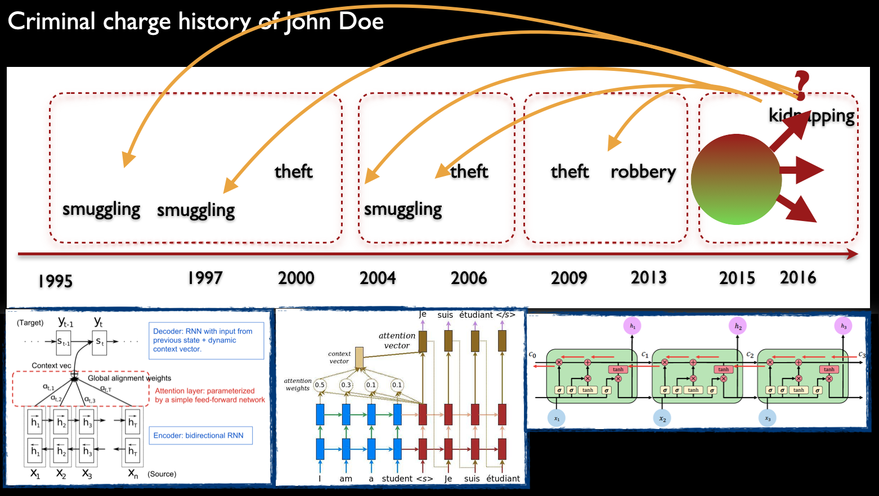
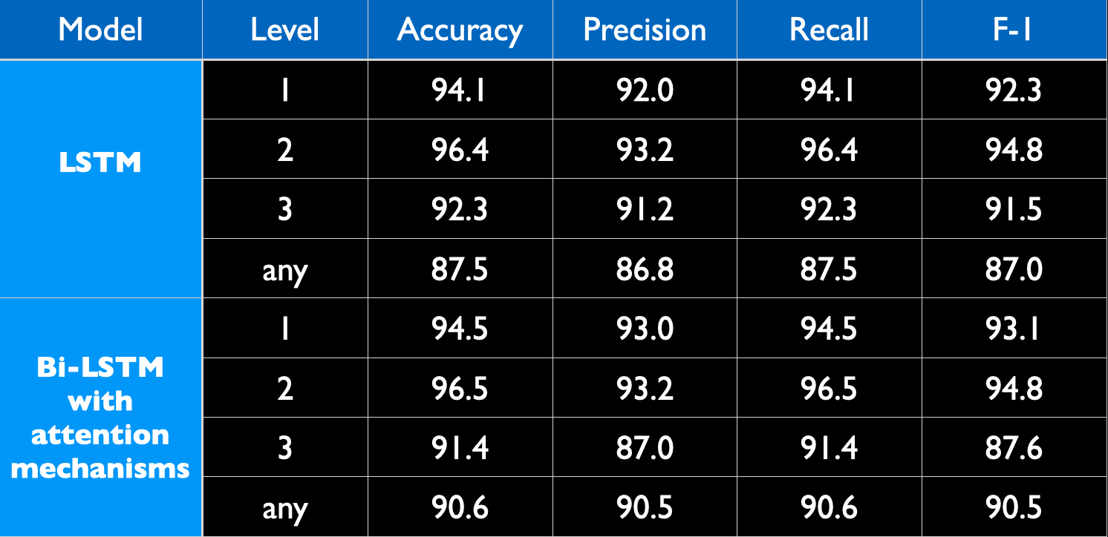

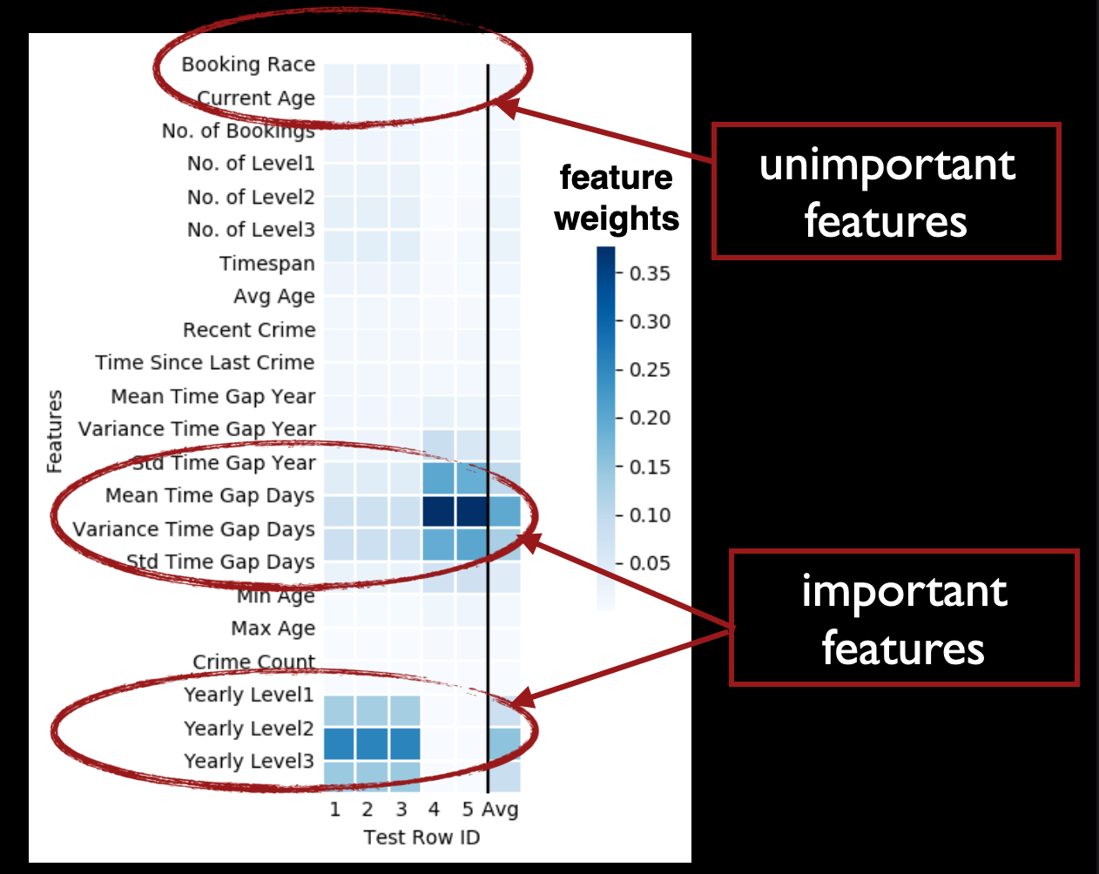
Deep Interpretable Criminal Charge Prediction and Algorithmic Bias
Abdul Rafae Khan = Jia Xu and Peter Varsanyi and Rachit Pabreja @ SIT and Rutgers
use deep learning for criminal charge prediction
two challenges: imbalanced data (low F-1), interpretability
Bi-LSTM capture temporal patterns of individual behaviors
attention mechanisms for post-hoc interpretability
criminal charge histories are essential features, while social features such as race, gender, and age are not.

